Slide 1
Working Together with your CPD Field Office
Katy Burke, Director, CPD Office of Field Management
June 23, 2022 - NCDA

Slide 2
Solving the Puzzle
Successful CPD grant management is a puzzle with a thousand pieces.
So where does the field office fit in?

Slide 3
Solving the Puzzle
Who is your CPD Field Office?
What do we do?
How to work together successfully?

Slide 4
Survey Says?

Slide 5
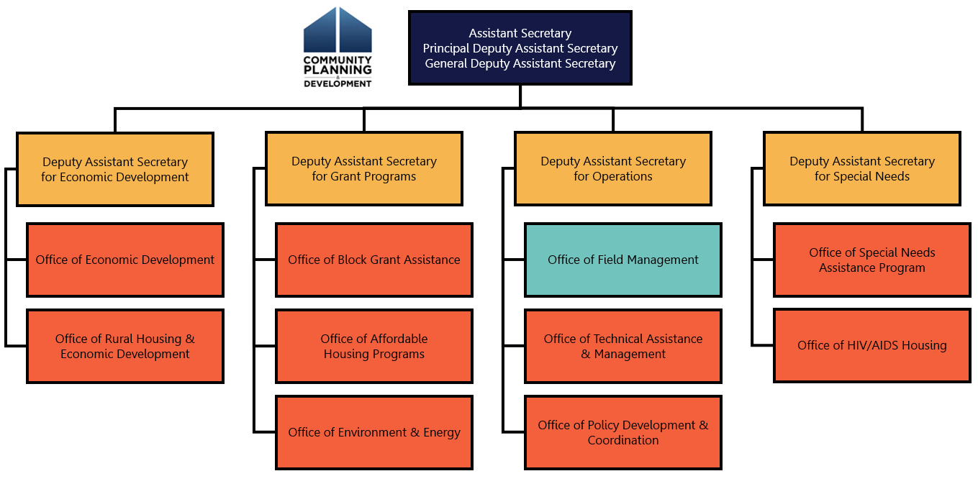
Who is Community Planning & Development?
National division of HUD
9 program offices
43 field offices

Slide 6
OBGA
RHP
NSP
CDBG
Guidance
Guidance
Guidance
Policy
Policy
Deadlines
Deadlines
Policy
Deadlines
CPD Field Office

Slide 7
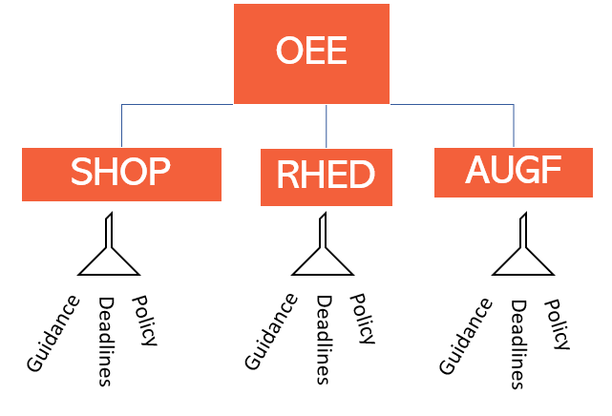
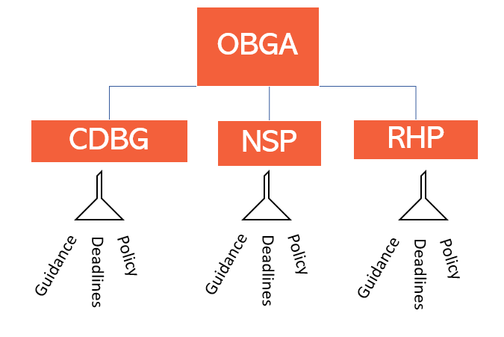
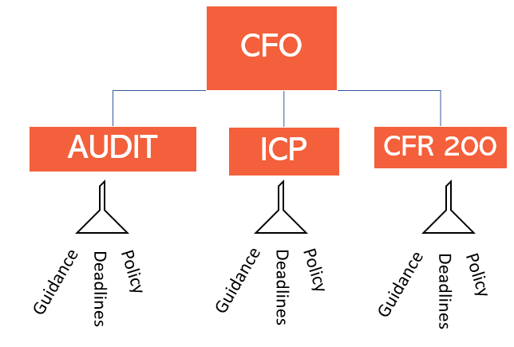
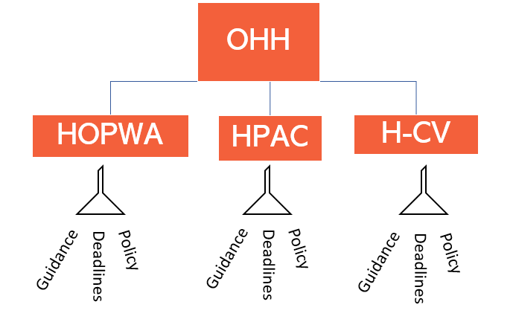
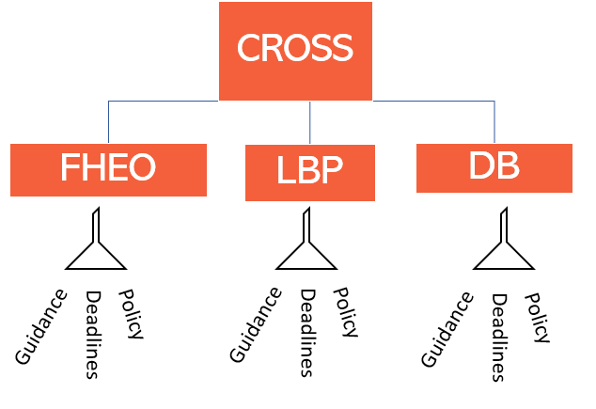
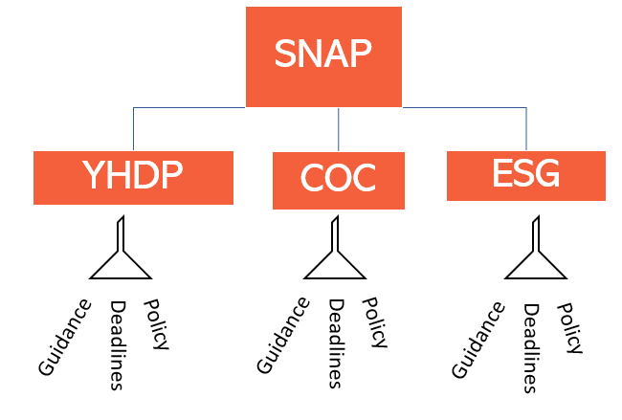
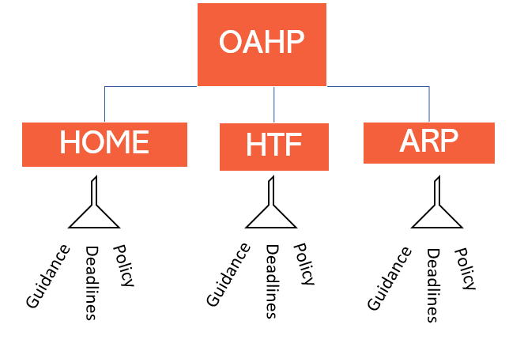
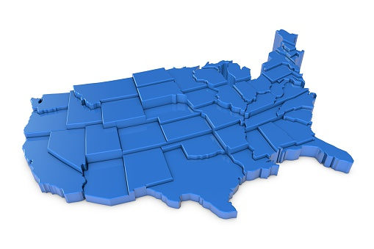
43 CPD Field Offices

Slide 8
CPD Office of Field Management

Slide 9
Field Office Stats
Overseen by: Office of Field Management
Leadership: CPD Director or Acting CPD Director
Management: Program Managers
Program Staff: CPD Representatives, Financial Analysts, Admin
SMEs: Environment, Relocation, Disaster

Slide 10
Field Office Stats
Field Team Snapshot
1 day to 45+ years
Former Grantees, Nonprofits
From GED to PhD
Lived Experience
Veterans, RPCVs, Americorps
HQ-to-Field, other agencies

Slide 11
So what does the Field Office do?
HQ Policy
CPD Field
Real
World

Slide 12
We do a few things…
CPD Field staff are asked to be experts for the following HUD programs and subject areas:
COMMUNITY DEVELOPMENT BLOCK GRANT (CDBG) ENTITLEMENT
STATE COMMUNITY DEVELOPMENT BLOCK GRANT (CDBG) PROGRAM
SECTION 108 LOAN GUARANTEES, ECONOMIC DEVELOPMENT INITIATIVE (EDI), AND BROWNFIELDS ECONOMIC DEVELOPMENT INITIATIVE (BEDI)
DISASTER RECOVERY COMMUNITY DEVELOPMENT BLOCK GRANT
HOME INVESTMENT PARTNERSHIPS PROGRAM (HOME)
ECONOMIC RECOVERY PROGRAMS
HOUSING OPPORTUNITIES FOR PERSONS WITH AIDS
SECTION 8 MODERATE REHABILITATION SINGLE ROOM OCCUPANCY ( SRO) PROGRAM FOR HOMELESS INDIVIDUALS
SHELTER PLUS CARE
SUPPORTIVE HOUSING PROGRAM (SHP)
ROUND II EMPOWERMENT ZONES
RURAL HOUSING AND ECONOMIC DEVELOPMENT
CITIZEN PARTICIPATION
ENVIRONMENTAL MONITORING
FAIR HOUSING AND EQUAL OPPORTUNITY
LABOR STANDARDS ADMINISTRATION
LEAD-BASED PAINT COMPLIANCE
RELOCATION AND REAL PROPERTY ACQUISITION
FLOOD INSURANCE PROTECTION
EMERGENCY SOLUTIONS GRANTS (ESG) PROGRAM
CONTINUUM OF CARE (CoC) PROGRAM
COMMUNITY CAPITAL INITIATIVES (CCI)
SELF-HELP HOMEOWNERSHIP OPPORTUNITY PROGRAM (SHOP)
RURAL CAPACITY BUILDING FOR COMMUNITY DEVELOPMENT AND AFFORDABLE HOUSING GRANTS (RCB)
CAPACITY BUILDING FOR COMMUNITY DEVELOPMENT AND AFFORDABLE HOUSING GRANTS (SECTION 4)
2 CFR PART 200, UNIFORM ADMINISTRATIVE REQUIREMENTS, COST PRINCIPLES, AND AUDIT REQUIREMENTS FOR FEDERAL AWARDS
CLOSEOUTS
FINANCIAL MANAGEMENT
INTERNAL CONTROLS
BONDS
PAYMENT AND FINANCIAL REPORTING
IMPROPER PAYMENTS
COST SHARING OR MATCHING
PROGRAM INCOME
REVISION OF BUDGET AND PROGRAM PLANS
PERIOD OF PERFORMANCE
Record retention and access
AUDIT REQUIREMENTS
DIRECT COSTS
INDIRECT COSTS
DE MINIMIS RATE
PROCUREMENT POLICIES AND PROCEDURES
MICRO-PURCHASES
SMALL PURCHASES
SEALED BIDS
COMPETITIVE PROPOSALS
NONCOMPETITIVE PROPOSALS
CONTRACT COST AND PRICE
CONTRACT PROVISIONS
EQUIPMENT USE AND MANAGEMENT
EQUIPMENT DISPOSITION

Slide 13
HQ Policy → Field
CARES Act
Programs
NSP
Disaster
Earmarks
CDBG
RHP
CoC
ESG
HOME-ARP
Systems
SHOP
HOME
HTF
TA
IT
HOPWA
RROF
Part 50
Policy
Guidance
DRGR
Lead-Based Paint
Relocation
Citizen Particip.
USICH
DOE
Crosscutting
Environment
FEMA
2 CFR 200
Davis Bacon
EPA
CPD Field Office
eSnaps
VASH
IDIS
Other agencies
DOJ
eLOCCS
HHS
Fair Housing
Audit
VA

Slide 14
Field to Community
City
State
County
Nonprofit
HA
CPD Field Office

Slide 15
CPD Field Office
CPD Field Office = One-stop shop

Slide 16
CPD Field Offices…
Translate guidance to your specific question
Support with training, ideas, networks, SMEs
Review, monitor, flag, fix
CPD Field Office

Slide 17
Translate
TIPS & TRICKS
Be honest.
Be thorough.
Check your assumptions.
Answer shopping? Beware!
Translate guidance to your specific question.

Slide 18
Support
TIPS & TRICKS
Just ask!
Be flexible.
Forge User Groups with other cities.
Sorry - CPD can’t endorse
Know what TA can (and can’t) do
Support with training, ideas, networks, SMEs

Slide 19
Review
TIPS & TRICKS
It’s better to catch it early. Really.
Don’t fear the finding.
Cause & Effect – why did it happen, and who was hurt?
Psst – you have the test! (Mon. Exhibits!)
Review, monitor, flag, fix

Slide 20
A quick word about Findings…
Bachelor of Monitoring & Findings

Slide 21
Walking the Tightrope
Your CPD Field Office!
Compliance
Taxpayers
Policy
Congress
Health & Safety
VS.
Customer Service
Community Building
“Good” Projects
Exceptional Circumstances

Slide 22
How to work with my Field Office?
HQ Policy
Real
World

Slide 23
TELL ME WHY!
Why does it seem like I hear different answers?
TA Provider
Conference w/HQ
Grantee
CPD Field Office
HQ Program Office
Grantee
CITY COUNCIL!
DEADLINES!
Email w/Field
AAQ/HUDExchange

Slide 24
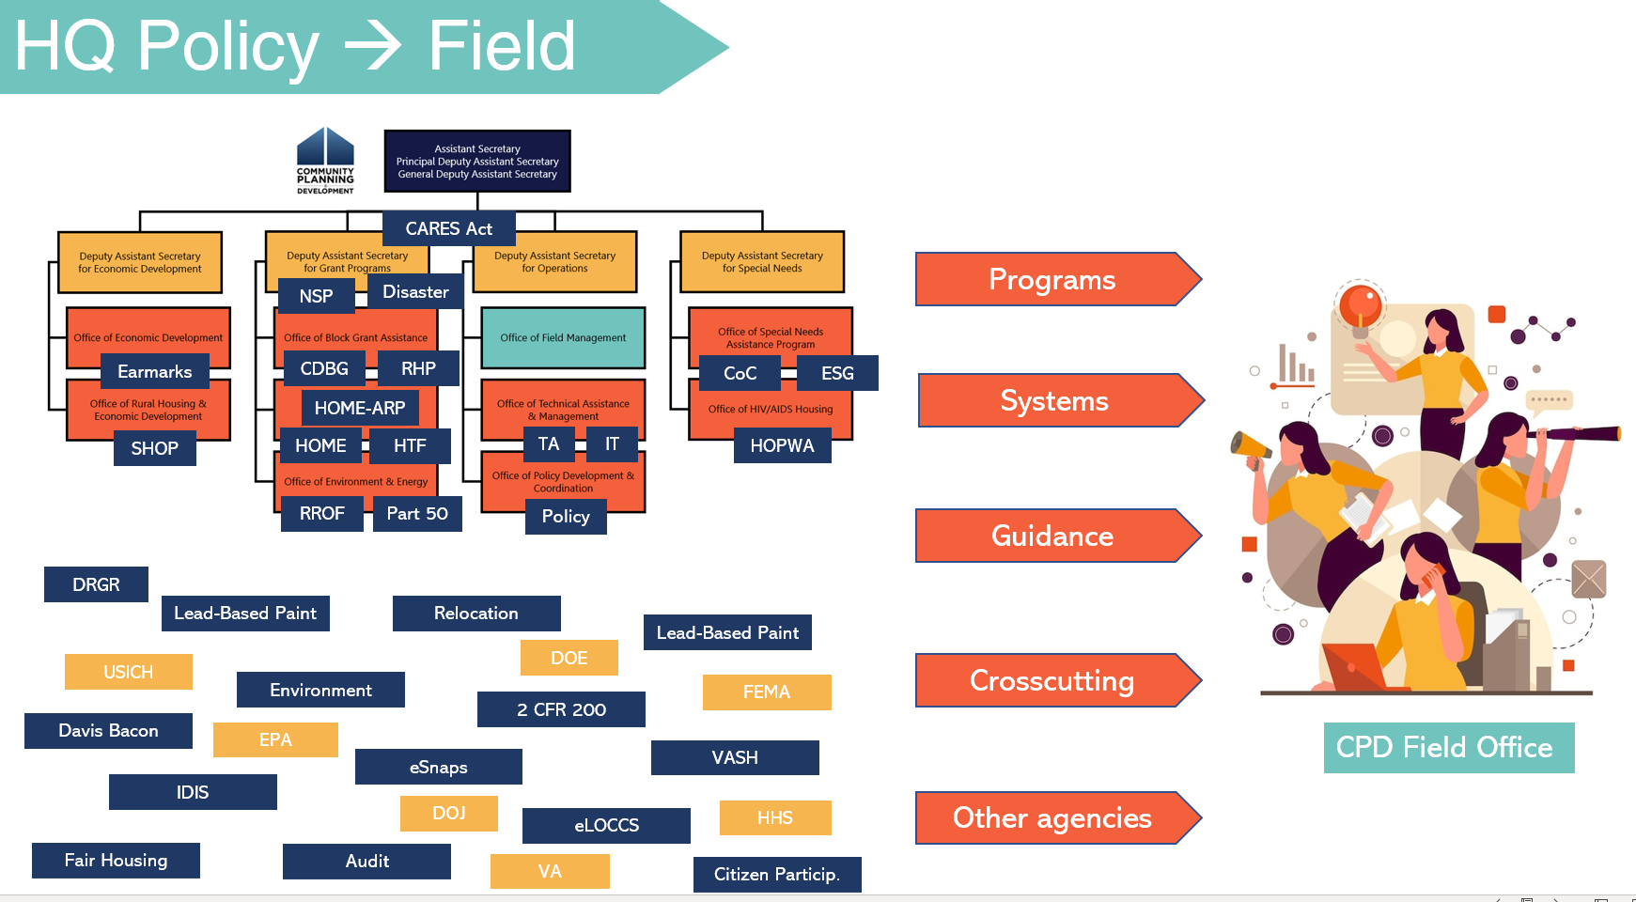
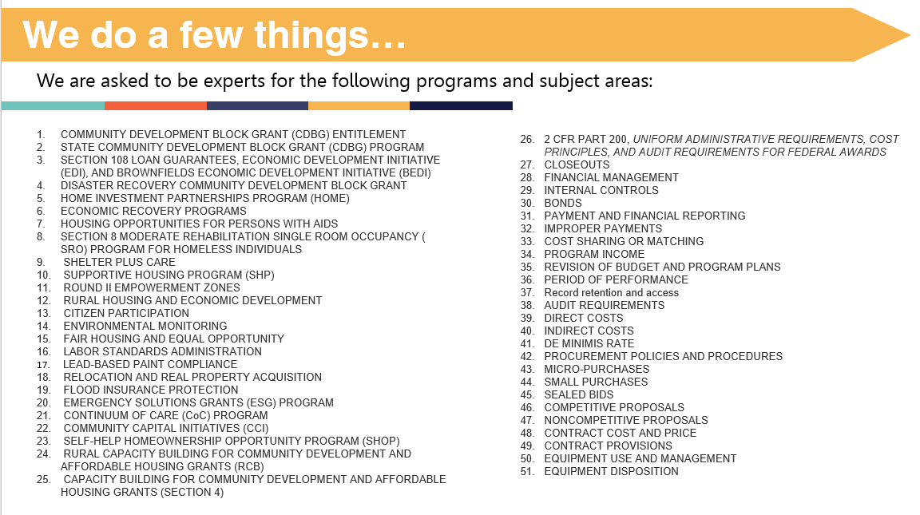
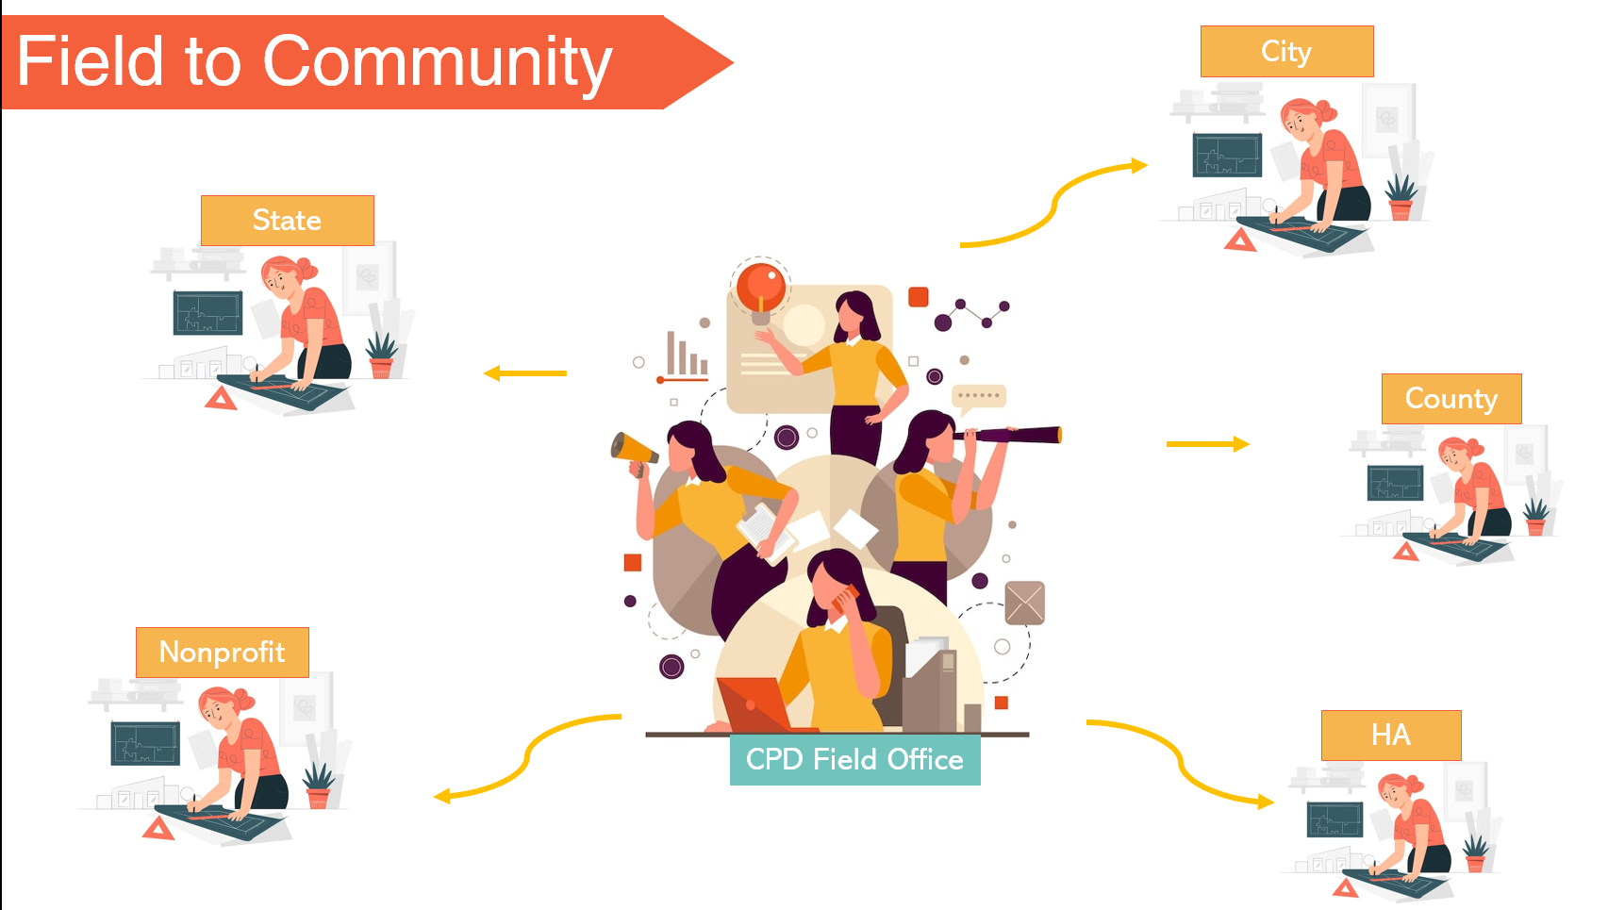
TELL ME WHY!
Why does it seem like I hear different answers?

Slide 25
TELL ME WHY!
Why does it seem like I hear different answers?
Sometimes HQ doesn’t tell the field what it tells grantees.
Information overload (just like you!)
Selective details from the question asker.
Every situation is different.
Know who you’re asking – TA Provider, Consultant, HQ, FO, SME, another city?

Slide 26
What do I do if…
I disagree with the guidance that was given?
Identify why you disagree, and give your FO the source.
Ask the manager to weigh in.
Ask to elevate to the desk officer.
Submit to AAQ and tell your Rep (they can see/track responses)
What if I have someone in HQ’s email?
Please don’t – your email will be forwarded anyway. More time/work.
If you must… cc: your CPD Director.

Slide 27
TELL ME WHY!
Why is it taking FOOORRREEEVER to get an answer to my question?
Your question may be in a queue:
At the FO
With the SME
At HQ
Your question might need legal review.
< Insert lawyer joke here >
Your question may be pending an upcoming release of Notice, Regs, FAQ, etc

Slide 28
What do I do if…
I need a decision now?
Send a reminder!
Explain the context.
Ask who needs to make the decision.
Ask for in-the-meantime guidance.
Ask what additional information you can provide to support your request.
I can’t get a decision now?
Determine what is the risk level of what holding you up.
Is it a project-killer if you get it wrong?
Make a decision, document, and move forward – at your own risk.

Slide 29
TELL ME WHY!
Why does a “small problem” snowball into shutting down a project?
We are trying to protect you!
Know your project-killers:
Choice-limiting actions (acq.)
Incorrect level of Environmental Review
Committing funds prior to written agreement (HOME, HTF)
Not identifying relocation triggers (acq., rehab, demo)
Using debarred/unverified partners, poor procurement practices
Negative media coverage/legal liability
TIP: Treat every project like a HUD project.

Slide 30
What do I do if…
I think we committed a Project-Killer?
Speak now. Earlier = more options for waivers or alternative funding
I’m afraid that flagging one issue will lead to monitoring?
Monitoring is based on annual risk.
Discovering and fixing problems > hiding them to be discovered later

Slide 31
GET. TO. YES!
How can I “get to yes” on my project?
Start with the field office. Every time!
Your CPD Rep is your gateway to resources, guidance, information and solutions.
Ask early, ask often, and do your research!

Slide 32
GET. TO. YES!
How can I “get to yes” on my project?
Tell CPD your end goal.
Be open to different ways of doing things.
Differentiate between political/local preferences and the realm of what’s possible.
Know your parameters: activity eligibility, target population, financial soundness, environmental compliance
We can give you options – not THE ANSWER.

Slide 33
WORKING TOGETHER
The CPD field office is your Partner.
We are here to work together with you to achieve your community development objectives.

Slide 34
CPD Field is here to help you put the pieces in place.

